Slide 1
INTELLIGENT PLATFORM FOR
AUTOMATED MONITORING AND SECURITY
SOC + AI + SOAR
A Production-Grade Security Operations Center
Ghazi Mabrouki
ArcTic 3 | Huawei Enterprise — Cloud Department, Innovation Department
2026
FINAL YEAR PROJECT

Slide 2
EXECUTIVE OVERVIEW
01
02
03
04
Introduction
& Context
Problem &
Existing Solutions
Solution &
Architecture
Detection
Layer
Cybersecurity challenges, SOC importance, industry context
Limitations of current SIEM/SOC solutions, market gaps
Platform overview, global architecture, three-phase implementation
Suricata, Wazuh, Falco — network, host, runtime detection
05
06
07
08
Correlation &
Incident Lifecycle
AI Intelligence
Layer
SOAR &
Automation
Testing &
Results
Smart correlation logic, alert-to-incident flow, lifecycle management
AI response engine, assistant, operator, root cause analysis
Approval workflows, Ansible execution, automated remediation
Testing strategy, achieved results, before vs after comparison
Ghazi Mabrouki | Huawei Enterprise — Cloud Department
02 / 37

Slide 3
01
Cybersecurity challenges, SOC strategic importance, and the industry imperative for intelligent security operations in cloud and distributed environments.
INTRODUCTION
& CONTEXT

Slide 4
01 INTRODUCTION
02 PROBLEM
03 ARCHITECTURE
04 DETECTION
05 CORRELATION
06 AI LAYER
07 SOAR
08 TESTING
Context & Cybersecurity Challenges
Fragmented Tools
Heterogeneous Data
Alert Noise & False Positives
Multiple disconnected security consoles with no centralization, complicating global infrastructure management.
Network logs, host events, container runtime, and metrics in different formats — difficult to analyze uniformly.
Analysts drown in raw technical alerts without context, correlation, or prioritization.
Manual, Slow Investigations
Poor Incident Understanding
Lack of Automation
Correlation across tools requires expert knowledge and significant time, delaying response.
Alerts are technical and difficult to interpret for rapid decision-making by non-experts.
Corrective actions are rarely automated, increasing reaction time against active threats.
THE RESULT
Slower incident response, missed multi-stage attack patterns, and analyst burnout from manual correlation across disconnected tools.
Ghazi Mabrouki | Huawei Enterprise — Cloud Department
04 / 37

Slide 5
01 INTRODUCTION
02 PROBLEM
03 ARCHITECTURE
04 DETECTION
05 CORRELATION
06 AI LAYER
07 SOAR
08 TESTING
Project Objectives
1
COMPLETE VISIBILITY
2
INTELLIGENT PROCESSING
3
CONTROLLED RESPONSE
Monitor network, host, runtime, and infrastructure layers in one unified stack. No blind spots — every critical layer observed, collected, and centralized.
Transform raw alerts into enriched, correlated incidents with AI-powered analysis. From data overload to actionable, contextualized intelligence.
Automate investigation, playbook generation, approval workflows, and Ansible-based remediation with full audit trails. The platform thinks before it acts.
KEY DIFFERENTIATORS
■ Differentiate informational / suspicious / malicious
■ Distinguish blocked vs successful attacks
■ Correlate events intelligently across sources
■ Produce real SOC-grade logic
■ Avoid "everything = attack" simplification
■ No repetitive generic remediation
Ghazi Mabrouki | Huawei Enterprise — Cloud Department
05 / 37

Slide 6
02
Why traditional SIEM/SOC approaches fall short and the identified gap in the security operations market.
PROBLEM &
EXISTING SOLUTIONS

Slide 7
01 INTRODUCTION
02 PROBLEM
03 ARCHITECTURE
04 DETECTION
05 CORRELATION
06 AI LAYER
07 SOAR
08 TESTING
The Problem — Security Operations Gaps
FRAGMENTED VISIBILITY
RAW DATA OVERLOAD
PASSIVE RESPONSE
Organizations watch only one layer — network OR host OR runtime — creating dangerous blind spots attackers exploit.
SIEMs collect massive unstructured technical data. Analysts drown in alerts without context, correlation, or prioritization.
Most SOC platforms only detect and display alerts. Correlation, investigation, and remediation remain entirely manual.
THE RESULT
Slower incident response, missed multi-stage attack patterns, and analyst burnout from manual correlation across disconnected tools. Current systems suffer from no centralization, heterogeneous data, alert noise, manual investigation, poor understanding, and no automation.
CORE PROBLEM STATEMENT
■ Fragmented tools with no centralization — security teams juggle multiple disconnected consoles
■ Heterogeneous data sources — impossible to analyze in a unified, coherent manner
■ High alert noise — analysts waste time on false positives instead of real threats
■ No automated response — every corrective action requires manual intervention
Ghazi Mabrouki | Huawei Enterprise — Cloud Department
07 / 37

Slide 8
01 INTRODUCTION
02 PROBLEM
03 ARCHITECTURE
04 DETECTION
05 CORRELATION
06 AI LAYER
07 SOAR
08 TESTING
Existing Solutions & Identified Gap
Category | Examples | Limitations
SIEM Traditional | Splunk, QRadar, ArcSight | Centralized collection but costly and complex to deploy
EDR / XDR | CrowdStrike, SentinelOne | Focused on endpoints, limited network visibility
SOAR | Palo Alto XSOAR, Splunk SOAR | Advanced orchestration but costly integration
Open-Source | Wazuh, Suricata, ELK Stack | Powerful but not natively integrated
Cloud Platforms | Azure Sentinel, Chronicle | Vendor lock-in, limited customization
GAP IDENTIFIED
No solution combines multi-layer monitoring, automatic enrichment, incident correlation, AI analysis, and automated remediation in a unified, cloud-deployable architecture.
Ghazi Mabrouki | Huawei Enterprise — Cloud Department
08 / 37

Slide 9
03
Platform overview, key innovations, and the complete three-phase architecture with full data pipeline.
PROPOSED SOLUTION
& ARCHITECTURE

Slide 10
01 INTRODUCTION
02 PROBLEM
03 ARCHITECTURE
04 DETECTION
05 CORRELATION
06 AI LAYER
07 SOAR
08 TESTING
Solution Overview & Key Innovation
A centralized intelligent SOC platform integrating log collection, advanced threat detection, multi-layer security monitoring, AI-powered incident explanation, and automated remediation using Ansible.
KEY INNOVATION
AI + Correlation + Automation — the platform doesn't just collect alerts; it understands them, correlates across sources, explains in natural language, and automates response with human-in-the-loop control.
THREE-PHASE IMPLEMENTATION
P1
Monitoring Foundation
P2
Cloud Infrastructure
P3
Backend Intelligence
Suricata + Wazuh + Falco + Telegraf → Filebeat → Elasticsearch → Kibana. Complete visibility backbone.
Huawei Cloud deployment with VPC, Security Groups, ECS VM (64 vCPU / 128 GB RAM). Secure and scalable.
12-step pipeline: ingestion → enrichment → correlation → AI → approval → Ansible → verification → archive.
Result: A unified SOC platform that sees everything, understands patterns, and responds with control. The platform thinks before it acts.
Ghazi Mabrouki | Huawei Enterprise — Cloud Department
10 / 37

Slide 11
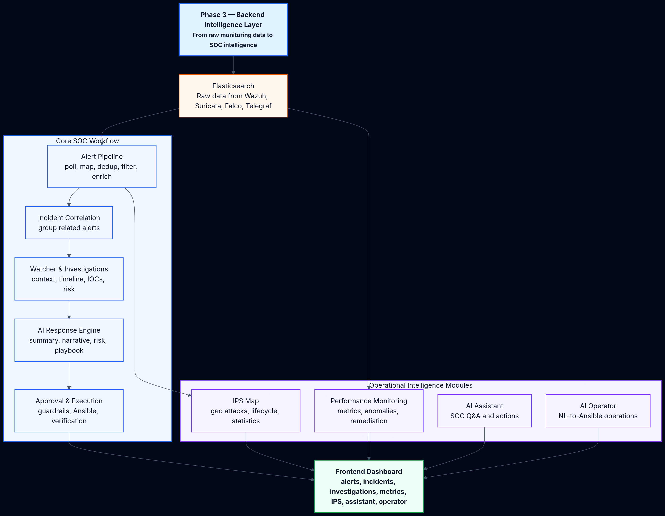
01 INTRODUCTION
02 PROBLEM
03 ARCHITECTURE
04 DETECTION
05 CORRELATION
06 AI LAYER
07 SOAR
08 TESTING
Global Architecture & Data Flow
Data Pipeline: Security Sources (Suricata, Wazuh, Falco, System logs) → Fluent Bit Collection → Kafka Streaming → ETL Processing + Threat Intel Enrichment → Neo4j Correlation → AI Layer (LLM/Ollama) → Elasticsearch + Kibana → Ansible SOAR Execution
Key Principle: Every component has a specific, well-defined role. The pipeline transforms raw security data into actionable intelligence through enrichment, correlation, and AI-powered analysis.
Ghazi Mabrouki | Huawei Enterprise — Cloud Department
11 / 37

Slide 12
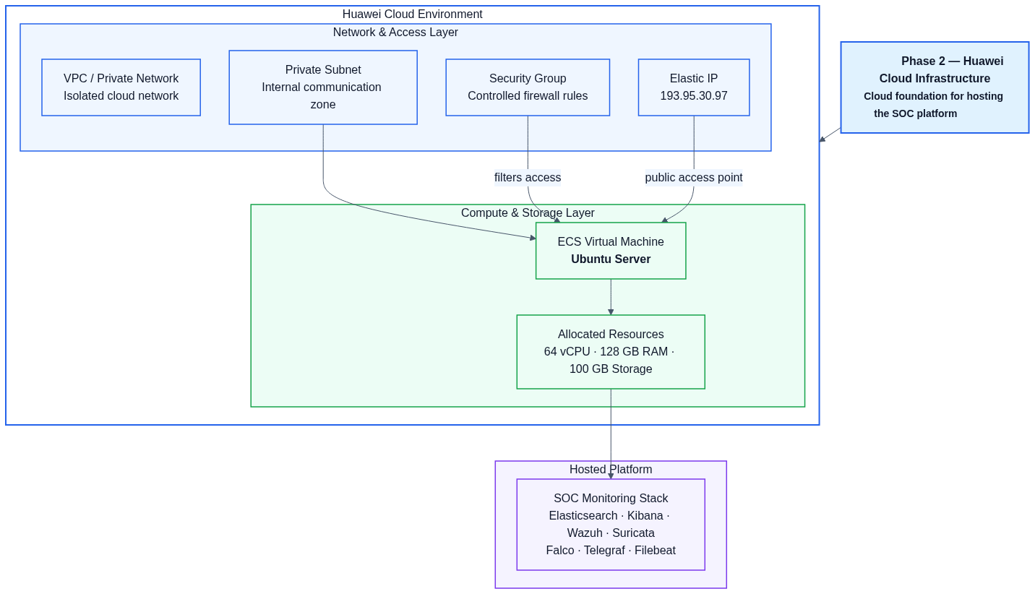
01 INTRODUCTION
02 PROBLEM
03 ARCHITECTURE
04 DETECTION
05 CORRELATION
06 AI LAYER
07 SOAR
08 TESTING
Three-Phase Implementation Strategy
PHASE 1
Monitoring Foundation
Collect, detect, store, and visualize security events. Suricata + Wazuh + Falco + Telegraf → Elasticsearch → Kibana
PHASE 2
Cloud Infrastructure
Deploy on Huawei Cloud with VPC, Security Groups, ECS VM (64 vCPU / 128 GB RAM). Secure access controls.
PHASE 3
Backend Intelligence
12-step pipeline: ingestion → enrichment → correlation → AI → approval → Ansible → verification → archive
INTELLIGENCE FLOW
Raw ES Data → Clean Alerts → Correlated Incidents → Investigations → AI Summaries & Playbooks → Approval → Execution → Verification → Archives → Dashboards
Each phase produces an operational increment. The platform transforms raw monitoring data into actionable SOC intelligence.
Ghazi Mabrouki | Huawei Enterprise — Cloud Department
12 / 37

Slide 13
04
Deep technical coverage of network, host, and runtime detection engines with their specific roles and capabilities.
DETECTION
LAYER

Slide 14
01 INTRODUCTION
02 PROBLEM
03 ARCHITECTURE
04 DETECTION
05 CORRELATION
06 AI LAYER
07 SOAR
08 TESTING
Suricata — Network Detection (NIDS)
Role: Network IDS providing traffic, packet, protocol, and IDS alert visibility. Suricata sees what happens ON THE WIRE — before attacks reach hosts.
DETECTION CAPABILITIES
INTEGRATION & OUTPUT
■ Port scans and network reconnaissance
■ Network exploits and vulnerability probes
■ C2 (Command & Control) communications
■ Protocol anomalies and misuse
■ Malware download attempts
■ DDoS and flooding patterns
■ Output: eve.json alerts → Filebeat
■ Indices: suricata-* in Elasticsearch
■ Mapped to normalized alert model
■ Full MITRE ATT&CK technique mapping
REAL SOC LOGIC
Suricata port scan detection + Wazuh brute force from same IP = correlated attack pattern, not isolated events. Cross-source correlation elevates confidence and reduces false positives.
Ghazi Mabrouki | Huawei Enterprise — Cloud Department
14 / 37

Slide 15
01 INTRODUCTION
02 PROBLEM
03 ARCHITECTURE
04 DETECTION
05 CORRELATION
06 AI LAYER
07 SOAR
08 TESTING
Wazuh — Host Detection (HIDS)
Role: Host and endpoint security monitoring — auth events, file integrity, agent alerts. Wazuh sees what happens ON THE HOST — user behavior, file changes, system calls.
DETECTION CAPABILITIES
INTEGRATION & OUTPUT
■ SSH brute force and authentication anomalies
■ File integrity monitoring (FIM)
■ Privilege escalation detection
■ Suspicious process execution
■ Malware detection and rootkit checks
■ User and command auditing
■ Indices: wazuh-alerts-* via Filebeat
■ Full MITRE ATT&CK mapping
■ Severity classification per rule
■ Agent-based distributed coverage
REAL SOC LOGIC
Failed logins → successful login → file change = potential compromise chain. Wazuh tracks the full host-level attack progression that network tools alone cannot see.
Ghazi Mabrouki | Huawei Enterprise — Cloud Department
15 / 37

Slide 16
01 INTRODUCTION
02 PROBLEM
03 ARCHITECTURE
04 DETECTION
05 CORRELATION
06 AI LAYER
07 SOAR
08 TESTING
Falco — Runtime & Container Detection
Role: Runtime and container security — process behavior, syscalls, container activity. Falco sees what happens AT RUNTIME — the final layer where attacks manifest.
DETECTION CAPABILITIES
INTEGRATION & OUTPUT
■ Abnormal process execution
■ Unauthorized syscall patterns
■ Container escape attempts
■ Sensitive file access detection
■ Crypto-mining detection
■ Reverse shell activity
■ Indices: falco-events-* via Falcosidekick
■ Container-aware detection
■ Kubernetes-native integration
■ Low-overhead kernel instrumentation
REAL SOC LOGIC
Network scan (Suricata) + shell activity (Falco) = active intrusion confirmed. Runtime detection provides the final confirmation layer that closes the visibility gap.
Ghazi Mabrouki | Huawei Enterprise — Cloud Department
16 / 37

Slide 17
05
When to raise alerts, when to create incidents, cross-source correlation logic, and the complete incident lifecycle from detection to resolution.
SMART CORRELATION
& INCIDENT LIFECYCLE

Slide 18
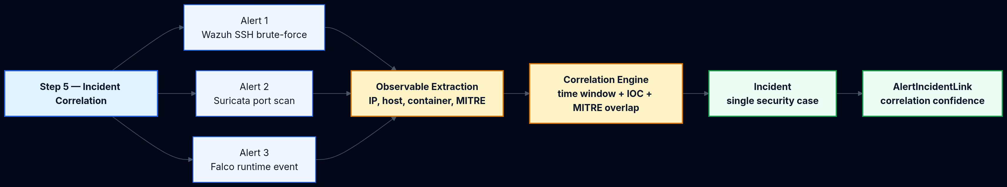
01 INTRODUCTION
02 PROBLEM
03 ARCHITECTURE
04 DETECTION
05 CORRELATION
06 AI LAYER
07 SOAR
08 TESTING
Smart Correlation Logic
INCIDENT CREATION RULES
■ Critical severity alert detected
■ Attack pattern: ssh_brute_force, port_scan, malware, c2
■ Kill-chain has 2+ MITRE phases
■ Medium severity + 2+ alerts in 15 min
CORRELATION SIGNALS
■ Source IP (same attacker origin)
■ Hostname/Container ID (same target)
■ MITRE tactics + time window overlap
CORRELATION EXAMPLE
Suricata detects a port scan + Wazuh detects SSH brute force from same IP + Falco detects shell activity = One stronger incident with higher confidence:
"SSH Brute Force & Port Scan Campaign from 185.220.101.4"
FALSE POSITIVE AVOIDANCE
Whitelist checks | Noise learner with auto-learned rules | Deduplication engine | Confidence scoring per correlation | Kill-chain progression validation
Ghazi Mabrouki | Huawei Enterprise — Cloud Department
18 / 37

Slide 19
01 INTRODUCTION
02 PROBLEM
03 ARCHITECTURE
04 DETECTION
05 CORRELATION
06 AI LAYER
07 SOAR
08 TESTING
Incident Lifecycle — From Alert to Archive
ALERT
INCIDENT
INVESTIGATION
AI ANALYSIS
PLAYBOOK
APPROVAL
EXECUTION
AUTOMATIC FLOW
HUMAN-IN-THE-LOOP
■ Watcher detects open incidents
■ Creates investigation with rich context
■ Triggers AI engine for analysis
■ Generates remediation playbook
■ Auto-approval check based on risk
■ Manual approval for high-risk cases
■ Analyst review for medium-risk
■ Auto-approval only for low-risk
■ Full audit trail for every decision
■ Analyst override at any stage
INVESTIGATION CONTEXT INCLUDES
Linked alerts timeline | IOCs (IPs, ports, services, domains) | MITRE tactics & techniques | Behavioral patterns | Risk score | Auth pattern analysis
Core Principle: The platform never executes blindly — every action passes through approval and validation gates.
Ghazi Mabrouki | Huawei Enterprise — Cloud Department
19 / 37

Slide 20
01 INTRODUCTION
02 PROBLEM
03 ARCHITECTURE
04 DETECTION
05 CORRELATION
06 AI LAYER
07 SOAR
08 TESTING
Alert Processing Pipeline
STEP 1
Cursor-based ES polling from all security indices
STEP 2
Source mappers normalize into one alert model
STEP 3
Alert processor: dedup → filter → enrich → whitelist
STEP 4
SQLite persistence + WebSocket broadcast
OUTPUT
Clean normalized alerts with: source, source_id, title, severity, category, IPs, hostname, tags, IOCs, MITRE techniques, metadata, dedup_key, occurrence_count
Ghazi Mabrouki | Huawei Enterprise — Cloud Department
20 / 37

Slide 21
06
The AI engine that explains alerts, performs root cause analysis, generates remediation playbooks, and enhances SOC analyst decision-making.
AI-POWERED
INTELLIGENCE LAYER

Slide 22
01 INTRODUCTION
02 PROBLEM
03 ARCHITECTURE
04 DETECTION
05 CORRELATION
06 AI LAYER
07 SOAR
08 TESTING
AI Response Engine
INPUT
PROCESSING
OUTPUT
Investigation context: timeline, IOCs, MITRE tactics, risk score, behavioral patterns
Circuit breaker → Prompt builder → LLM provider routing (Ollama, Gemini, OpenRouter, NVIDIA NIM)
Summary, attack chain narrative, risk assessment, YAML remediation playbook, auto-approval check
Important: The system does not blindly execute. Output goes through approval and validation before any action is taken.
Ghazi Mabrouki | Huawei Enterprise — Cloud Department
22 / 37

Slide 23
01 INTRODUCTION
02 PROBLEM
03 ARCHITECTURE
04 DETECTION
05 CORRELATION
06 AI LAYER
07 SOAR
08 TESTING
AI Assistant & AI Operator
AI ASSISTANT — CONVERSATIONAL ANALYST
AI OPERATOR — NL TO ANSIBLE
Question → Keyword extraction → Deep entity fetch → Context prompt → LLM answer → Suggested actions (approve, decline, execute, archive)
NL request → Reason intent → Match template or generate playbook → Approval gate → Execute Ansible → Parse output → Return analysis
Operator Templates: RAM usage | Disk usage | CPU processes | Open ports / SSH failures | Service status | Docker containers | Package check
Ghazi Mabrouki | Huawei Enterprise — Cloud Department
23 / 37

Slide 24
07
Controlled remediation through approval workflows, Ansible execution engine, and automated response capabilities.
SOAR &
AUTOMATION

Slide 25
01 INTRODUCTION
02 PROBLEM
03 ARCHITECTURE
04 DETECTION
05 CORRELATION
06 AI LAYER
07 SOAR
08 TESTING
Approval, Execution & Verification
APPROVAL TYPES
MANUAL
Analyst reviews and decides
AUTO-APPROVED
Low-risk cases only
BLOCKED
Critical / high-risk cases require senior analyst review
EXECUTION CONTROLS
■ Playbook YAML validation
■ SSH connectivity pre-check
■ Whitelist target protection + full logging
FIX VERIFICATION OUTCOMES
Outcome | Meaning
likely_fixed | Playbook succeeded, no new alerts detected
not_fixed | Alerts continue or verification failed
inconclusive | Some signals remain unclear after verification
Fundamental Principle: The backend never blindly executes — controlled remediation with full audit trails from detection to archive.
Ghazi Mabrouki | Huawei Enterprise — Cloud Department
25 / 37

Slide 26
01 INTRODUCTION
02 PROBLEM
03 ARCHITECTURE
04 DETECTION
05 CORRELATION
06 AI LAYER
07 SOAR
08 TESTING
Ansible Automation & SOAR Capabilities
AUTOMATED ACTIONS
Block IP
Firewall rules
Isolate Host
Network segmentation
Restart Services
Recovery actions
Patch Configs
Remediation
EXECUTION ENGINE STEPS
CONTROLS & AUDITABILITY
1. Load investigation and approval record
2. Validate playbook syntax
3. Check whitelist + dry-run mode
4. Test SSH connectivity
5. Write playbook and inventory files
6. Run ansible-playbook
7. Analyze exit code + broadcast completion
■ Playbook validation before execution
■ SSH connectivity check
■ Whitelist protection
■ Full execution logging
■ Status tracking per run
■ Shared engine for AI + operator
Turns investigation into action — with full controls and auditability. The shared execution engine (response/ansible_exec.py) handles both AI-generated and operator-requested playbook runs.
Ghazi Mabrouki | Huawei Enterprise — Cloud Department
26 / 37

Slide 27
08
Functional and non-functional requirements, agile development approach, and project management strategy.
REQUIREMENTS &
METHODOLOGY

Slide 28
01 INTRO
02 PROBLEM
03 ARCH
04 DETECT
05 CORR
06 AI
07 SOAR
08 REQ & METH
09 TEST
Functional Requirements
# | Requirement | Description
1 | Architecture & Cloud | Global architecture definition, secure cloud infrastructure (VPC, SG, EIP)
2 | Automated Deployment | Centralized installation scripts for all SOC components
3 | Elasticsearch & Kibana | Secure backend storage (TLS, auth), index patterns, dashboards
4 | Log Collection | Filebeat for system and security logs to Elasticsearch
5 | Metrics Monitoring | Telegraf for CPU, RAM, disk, network with dashboards
6 | NIDS/HIDS Detection | Suricata (network) + Wazuh (host) with detection rules
7 | Runtime Detection | Falco for syscalls and abnormal behaviors
8 | Dashboards & Alerting | Structured dashboards, detection rules, visualizations
9 | AI Layer | Automatic analysis, summaries, corrective actions with LLM
10 | Ansible Automation | Playbooks for system/infrastructure corrective actions
Ghazi Mabrouki | Huawei Enterprise — Cloud Department
28 / 37

Slide 29
01 INTRO
02 PROBLEM
03 ARCH
04 DETECT
05 CORR
06 AI
07 SOAR
08 REQ & METH
09 TEST
Non-Functional Requirements
PERFORMANCE
SECURITY
SCALABILITY
Dashboard response < 2s
Ingestion > 1000 events/sec
99.9% availability
TLS for all communications
Auth on all services
ES never publicly exposed
Full audit trail
Modular architecture
Horizontal scaling support
Adaptive cursor-based polling
RELIABILITY
MAINTAINABILITY
INTEROPERABILITY
SQLite local persistence
Circuit breaker on LLM
Graceful error handling
Centralized install scripts
YAML configuration
Complete logging
REST APIs
WebSocket real-time
Multi-provider LLM integration
Ghazi Mabrouki | Huawei Enterprise — Cloud Department
29 / 37

Slide 30
01 INTRO
02 PROBLEM
03 ARCH
04 DETECT
05 CORR
06 AI
07 SOAR
08 REQ & METH
09 TEST
Methodology — Agile & Iterative
Agile approach with 3 major phases — each phase produces an operational increment of the SOC platform. 2-week sprints, continuous code reviews, parallel documentation.
PHASE 1
Monitoring Foundation
PHASE 2
Cloud Infrastructure
PHASE 3
Backend Intelligence
Deliverables:
Documented architecture
Deployment scripts
Operational dashboards
End-to-end data flow validation
Deliverables:
Cloud infrastructure
Secure VPC/SG
Optimized resources
Production deployment
Deliverables:
Intelligence backend with APIs
AI engine integration
SOAR automation
Tests and documentation
SPRINT STRUCTURE
2-week cycles | Continuous code reviews | Parallel documentation | Automated tests each sprint | Integration testing at each sprint | End-to-end validation per phase
Ghazi Mabrouki | Huawei Enterprise — Cloud Department
30 / 37

Slide 31
09
Comprehensive testing strategy, achieved results, and before-vs-after platform comparison.
TESTING,
RESULTS & COMPARISON

Slide 32
01 INTRO
02 PROBLEM
03 ARCH
04 DETECT
05 CORR
06 AI
07 SOAR
08 REQ
09 TEST
Testing Strategy
UNIT TESTS
INTEGRATION TESTS
■ Alert mapper validation (Wazuh, Suricata, Falco)
■ Incident correlation logic
■ Enrichment engine (GeoIP, MITRE)
■ Playbook generation + YAML validation
■ Full flow ES → Pipeline → SQLite → API
■ LLM integration (Ollama, Gemini)
■ WebSocket broadcast
■ End-to-end alert lifecycle
FUNCTIONAL TESTS
PERFORMANCE & SECURITY
■ Simulated attack scenarios (brute-force, port scan)
■ Alert generation verification
■ Investigation and playbook validation
■ Approval workflow tests
■ Event load and dashboard latency
■ Continuous polling stability
■ Penetration testing + firewall rules
■ TLS/authentication + audit trails
Ghazi Mabrouki | Huawei Enterprise — Cloud Department
32 / 37

Slide 33
01 INTRO
02 PROBLEM
03 ARCH
04 DETECT
05 CORR
06 AI
07 SOAR
08 REQ
09 TEST
Results & Improvements
COMPLETE SOC PLATFORM
INTELLIGENCE PIPELINE
Multi-layer monitoring deployed on Huawei Cloud with secure stack
12 steps from raw data ingestion to fix verification with AI analysis
CONTROLLED AUTOMATION
ADVANCED AI MODULES
Ansible playbook generation, approval workflows, secure execution
Conversational assistant, NL operator, geo-attack visualization
SCALABLE ARCHITECTURE
64 vCPU / 128 GB RAM cloud deployment, VPC + Security Groups + TLS, modular horizontal scaling support
KEY IMPROVEMENTS
■ Reduced false positives through enrichment and correlation — alerts are validated before escalation
■ Better incident clarity via AI explanations — every incident has a narrative and risk assessment
■ Faster response through automation — playbooks generated and executed with approval gates
■ Improved SOC efficiency with assisted decision-making — AI assistant and operator augment analysts
Ghazi Mabrouki | Huawei Enterprise — Cloud Department
33 / 37

Slide 34
01 INTRO
02 PROBLEM
03 ARCH
04 DETECT
05 CORR
06 AI
07 SOAR
08 REQ
09 TEST
Before vs After — Naive vs Intelligent System
BEFORE (Naive System)
AFTER (Intelligent Platform)
■ Raw technical alerts without context
■ Isolated tool outputs
■ Manual correlation across disconnected systems
■ No incident differentiation (everything = attack)
■ Slow manual remediation
■ No audit trail
■ Analyst burnout from noise
■ Enriched alerts with GeoIP + MITRE context
■ Cross-source correlation with confidence scoring
■ Differentiated incidents (info/suspicious/malicious)
■ Blocked vs successful attack distinction
■ Automated playbook generation with approval gates
■ Complete audit trail from detection to archive
■ AI-assisted analyst decision-making
The platform transforms raw monitoring data into actionable SOC intelligence, operational visibility, and controlled response workflows.
Ghazi Mabrouki | Huawei Enterprise — Cloud Department
34 / 37

Slide 35
10
Project achievements, system value, and roadmap for future enhancements.
CONCLUSION

Slide 36
01 INTRO
02 PROBLEM
03 ARCH
04 DETECT
05 CORR
06 AI
07 SOAR
08 REQ
09 TEST
Achievements & Future Improvements
ACHIEVEMENTS
FUTURE IMPROVEMENTS
■ Built a realistic, production-oriented SOC platform — not a demo system
■ Complete visibility across all critical layers: network, host, runtime, infrastructure
■ Intelligent correlation that distinguishes real threats from noise
■ AI-powered analysis and natural language explanation
■ Controlled automation with human-in-the-loop approval
■ Deployed and validated on Huawei Cloud infrastructure
■ Predictive AI: Threat forecasting using historical pattern analysis
■ Automation expansion: Additional playbook templates and response actions
■ Multi-cloud support: Extension to hybrid and multi-cloud environments
■ Enhanced ML models: Custom-trained detection models for specific attack patterns
■ SOAR playbook marketplace: Community-driven playbook sharing
SYSTEM VALUE
A production-grade SOC platform that demonstrates deep understanding of security operations, intelligent correlation, AI-enhanced decision-making, and controlled automation — built for real enterprise deployment.
Ghazi Mabrouki | Huawei Enterprise — Cloud Department
36 / 37

Slide 37
THANK YOU
THE PLATFORM THINKS BEFORE IT ACTS
From raw data to intelligent SOC operations
Ghazi Mabrouki
ArcTic 3 | Huawei Enterprise — Cloud Department, Innovation Department
2026
FINAL YEAR PROJECT

